Slide 1
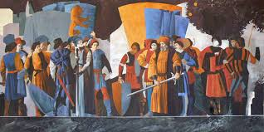
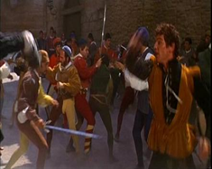
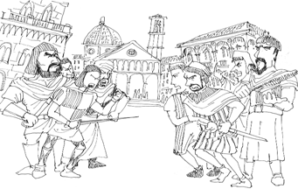
Act 1 Scene 1
“War”

Slide 2
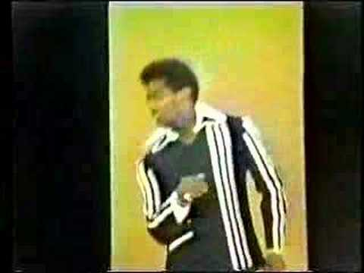
“War” by Edwin Starr
It [war] ain’t nothing but a heartbreaker
(War) friend only to the undertaker
Peace, love and understanding
Tell me, is there no place for them today
They say we must fight to keep our freedom
But lord knows there’s got to be a better way

